Slide 1
Open Science
What is it? Why do we care? How do we get there?

Slide 2
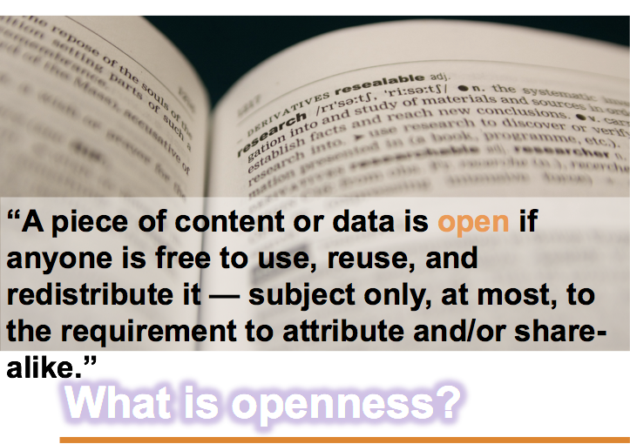

Slide 3
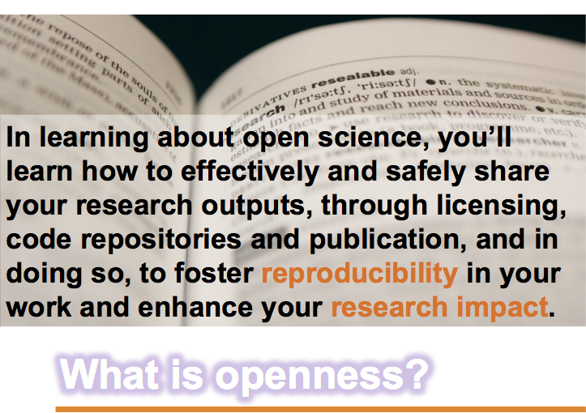

Slide 4
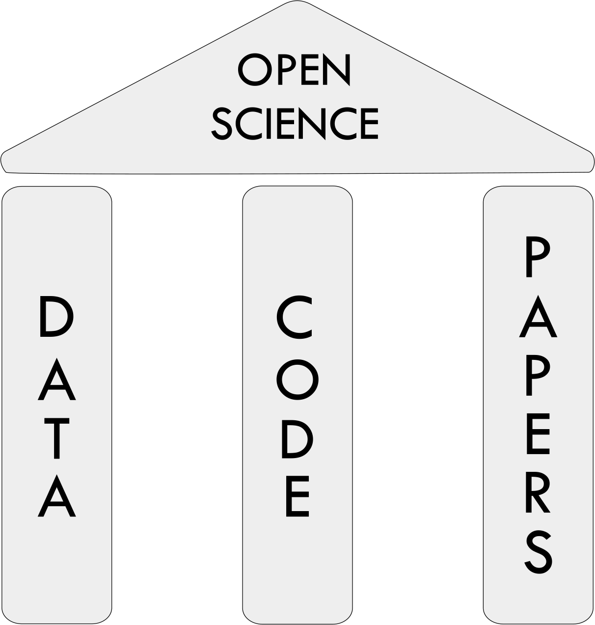
What is “open science”?
The replication crisis in science, including psychology, arises from a combination of factors, including poor research practices. In response, new methods and best practices have been introduced as part of what has aptly been called the “open science” movement. There is no single doctrine or paper that definitively captures open science. Rather, open science can be defined as a set of practices that increase the transparency and accessibility of scientific research (van der Zee & Reich, 2018).
Open science aims to bolster scientific research in part by testing the reproducibility and replicability of findings (Crüwell et al., 2018).
https://www.apa.org/science/about/psa/2019/02/open-science
Gorgolewski KJ, Poldrack RA (2016) A Practical Guide for Improving Transparency and Reproducibility in Neuroimaging Research. PLoS Biol 14(7): e1002506.

Slide 5
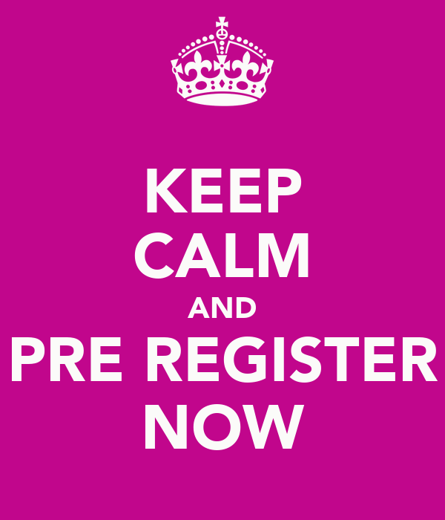
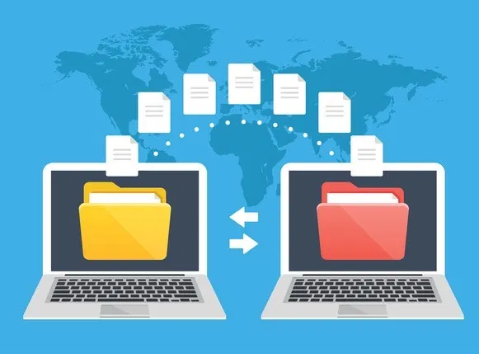
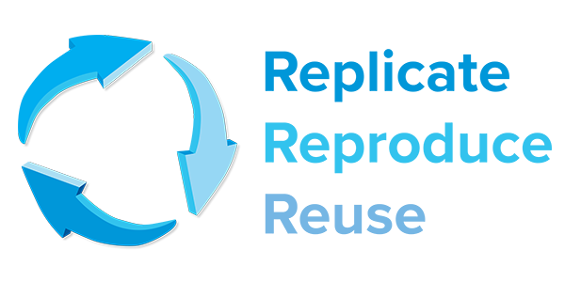
What we’ll touch on today
Reproducibility
Code/Data Sharing
Pre-Registration

Slide 6
Pre-Registration
Why is it important?
Helping plan & think through the reasons why you’re pursuing a question (and is not just to bind you)
Plan (better) analyses
Establish credibility by avoiding the garden of forking paths (link): it’s a solution to p-hacking
Helps prevent selective reporting of measures and possibly file drawer problem
When can you pre-register? (quoted directly from the Center for Open Science)
You can pre-register whenever, but common occurrences include:
Right before your next round of data collection
After you are asked to collect more data in peer review
Before you begin analysis of an existing data set

Slide 7
Pre-Registration
Why is it important?
Helping plan & think through the reasons why you’re pursuing a question (and is not just to bind you)
Plan (better) analyses
Establish credibility by avoiding the garden of forking paths (link): it’s a solution to p-hacking
Helps prevent selective reporting of measures and possibly file drawer problem
When can you pre-register? (quoted directly from the Center for Open Science)
You can pre-register whenever, but common occurrences include:
Right before your next round of data collection
After you are asked to collect more data in peer review
Before you begin analysis of an existing data set

Slide 8
Pre-Registration: What is it?
Preregistration (a.k.a. unreviewed preregistration)
The researcher creates as detailed a description of his or her plans for a study as possible and saves those plans in a time-stamped, uneditable archive. This record can be shared with reviewers, editors, and other researchers.
Registered Reports (a.k.a. reviewed preregistration)
The researcher submits a detailed proposal for a study to a journal before conducting the study. These registered reports have the same virtues as preregistration, but they also address the problem of publication bias because the studies are published regardless of their outcomes. Registered Reports are most useful for well-defined research domains in which reviewers can reasonably assess the likelihood that a proposed study will be informative regardless of its outcome. (Click here for a list of such journals and for a more extensive discussion.)
Note: Even though journals will not reject based upon outcome, they may still reject (after the initial review) if the implementation has problems
Registered Replication Reports (RRR)
A variant of Registered Reports, RRRs are focused on direct replication of one or more original findings. Many labs follow the same preregistered plan, and the results from all of those independent studies are published collectively regardless of the outcomes of individual studies. Variants of such reports include RRRs in Perspectives on Psychological Science and the ManyLabs project, among others.

Slide 9
Pre-Registration: What is it?
Preregistration (a.k.a. unreviewed preregistration)
The researcher creates as detailed a description of his or her plans for a study as possible and saves those plans in a time-stamped, uneditable archive. This record can be shared with reviewers, editors, and other researchers.
Registered Reports (a.k.a. reviewed preregistration)
The researcher submits a detailed proposal for a study to a journal before conducting the study. These registered reports have the same virtues as preregistration, but they also address the problem of publication bias because the studies are published regardless of their outcomes. Registered Reports are most useful for well-defined research domains in which reviewers can reasonably assess the likelihood that a proposed study will be informative regardless of its outcome. (Click here for a list of such journals and for a more extensive discussion.)
Note: Even though journals will not reject based upon outcome, they may still reject (after the initial review) if the implementation has problems
Registered Replication Reports (RRR)
A variant of Registered Reports, RRRs are focused on direct replication of one or more original findings. Many labs follow the same preregistered plan, and the results from all of those independent studies are published collectively regardless of the outcomes of individual studies. Variants of such reports include RRRs in Perspectives on Psychological Science and the ManyLabs project, among others.

Slide 10
Pre-Registration: What is it?
Preregistration (a.k.a. unreviewed preregistration)
The researcher creates as detailed a description of his or her plans for a study as possible and saves those plans in a time-stamped, uneditable archive. This record can be shared with reviewers, editors, and other researchers.
Registered Reports (a.k.a. reviewed preregistration)
The researcher submits a detailed proposal for a study to a journal before conducting the study. These registered reports have the same virtues as preregistration, but they also address the problem of publication bias because the studies are published regardless of their outcomes. Registered Reports are most useful for well-defined research domains in which reviewers can reasonably assess the likelihood that a proposed study will be informative regardless of its outcome. (Click here for a list of such journals and for a more extensive discussion.)
Note: Even though journals will not reject based upon outcome, they may still reject (after the initial review) if the implementation has problems
Registered Replication Reports (RRR)
A variant of Registered Reports, RRRs are focused on direct replication of one or more original findings. Many labs follow the same preregistered plan, and the results from all of those independent studies are published collectively regardless of the outcomes of individual studies. Variants of such reports include RRRs in Perspectives on Psychological Science and the ManyLabs project, among others.

Slide 11

Pre-Registration
Best Practices Guide https://docs.google.com/document/d/1bh-Cn7U1jo8K5BqVF9aWWgbiap4GYB8PTZOrJpbr9W8/edit
How to pre-register?
How to pre-register on OSF
A practical guide for transparency in psychological science (Klein et al. 2018)
10 Things to Know About Pre-Analysis Plans
Where to pre-register (repositories)?
Open Science Framework is the most broadly applicable across social sciences
AsPredicted.org (Psychology mainly)
AEA Registry (Economics mainly)
EGAP (Political Science mainly)
Clinicaltrials.gov (Medicine / Public Health mainly)
Templates for pre-registration
OSF templates for different study designs and for different levels of detail
Templates compiled from Stanford Psych folks
Example pre-registrations
Examples compiled from Stanford Psych folks

Slide 12
What we’ll touch on today
Reproducibility
Code/Data Sharing
Pre-Registration

Slide 13
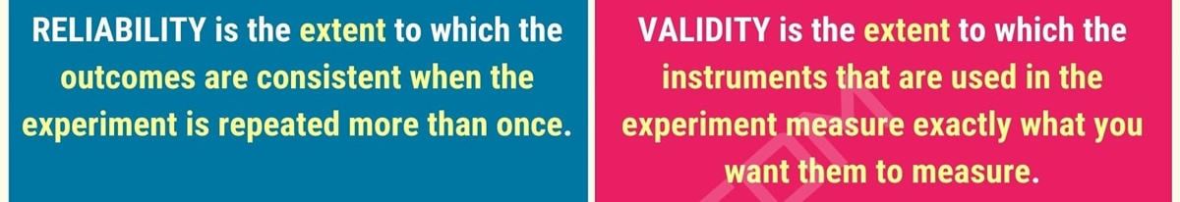
Reproducibility: What is it?
The primary goal of reproducible data analysis is to ensure computational reproducibility --- that is, the ability of another researcher to use one’s code and data to independently obtain identical results. However, the fact that a particular analysis is reproducible does not mean that it is correct.
This is related to the distinction between reliability (the consistency or precision of the results) and validity (the accuracy of the results). A second goal of reproducible data analysis is to ensure that the results generated by the code are correct.

Slide 14
Reproducibility: What is it?
An additional goal is to allow tracking of the provenance of any particular result (figure, table, or other result), which refers to the process through which that result was obtained. One way to think of this is to imagine the path from a particular result described in a manuscript back to the original data, describing all of the code as well as any intermediate results that are used in generating the published result.

Slide 15
Reproducibility: What is it?
Traditional manuscripts include text and result figures and tables that are produced by analysis code and data that are separate from the manuscript itself. The goal of “reproducible manuscripts”, as the name implies, is to publish in a format that allows for ease in re-running the original analyses accurately. This allows one to more conclusively identify the provenance of any published results and test their reproducibility, as well as apply the same analyses to new data.

Slide 16
Reproducible Data Analysis: Guiding Principles
There are several global decisions that one can make that will make it easier to work in a reproducible way. These are admittedly opinionated views that may be differently applicable in different research domains.
Use only free/open-source software whenever possible. This makes it easier for anyone else to reproduce your work without needing to buy particular software.
Minimize manual analysis steps. Any analysis operation that can be automated should be automated, using some form of script. Never perform manual data reorganization or file renaming operations.
Commit to a standard organization scheme. Using a standard scheme may sometimes require a bit more work in the short term, but will have significant payoffs in the longer term.
Commit to improving your skills as a software developer. Software development is a set of skills that must be learned, just like a new spoken language or musical instrument. The best way to advance one’s skills is through consistent and deliberate practice. Commit to reading the materials on software engineering that are outlined in the Resource section below, and working to implement those techniques in your coding practices.
It can be particularly useful to learn about “anti-patterns” (i.e. commonly used worst practices) for one’s language
Python: https://docs.quantifiedcode.com/python-anti-patterns/
R: The R Inferno

Slide 17
Reproducible Data Analysis: Guiding Principles
There are several global decisions that one can make that will make it easier to work in a reproducible way. These are admittedly opinionated views that may be differently applicable in different research domains.
Use only free/open-source software whenever possible. This makes it easier for anyone else to reproduce your work without needing to buy particular software.
Minimize manual analysis steps. Any analysis operation that can be automated should be automated, using some form of script. Never perform manual data reorganization or file renaming operations.
Commit to a standard organization scheme. Using a standard scheme may sometimes require a bit more work in the short term, but will have significant payoffs in the longer term.
Commit to improving your skills as a software developer. Software development is a set of skills that must be learned, just like a new spoken language or musical instrument. The best way to advance one’s skills is through consistent and deliberate practice. Commit to reading the materials on software engineering that are outlined in the Resource section below, and working to implement those techniques in your coding practices.
It can be particularly useful to learn about “anti-patterns” (i.e. commonly used worst practices) for one’s language
Python: https://docs.quantifiedcode.com/python-anti-patterns/
R: The R Inferno

Slide 18
Reproducible Data Analysis: Getting Started
Step 1: Create a reproducible environment
The environment comprises all of the software components that are necessary to perform a particular operation. This includes the code and data as well as any dependencies (such as software libraries) that are necessary to run the code.
Step 2: Use version control for everything
All work done on a computer for a project should be tracked using a version control system, including file name changes and reorganization. This allows the history of all code and operations to be tracked.
Step 3: Code Understandably
Your code should be understandable to a reader who is familiar with the language, preferably without the need for many comments in the code.
More info here: https://docs.google.com/document/d/1xQywZPrNDLkGPlsCVhCKT5yWBD-Rko0fGk2pjH_eCng/edit#

Slide 19
Reproducible Data Analysis: Getting Started
Step 4: Code defensively
Assume that errors will occur, and create code that will be robust to those errors and/or will call attention to them when they exist.
Step 5: Code portably
Assume that your code will need to run on other computers, so that details about your specific computer should not be stored in the code itself.
Step 6: Automate your workflow
The goal of automation is to allow one to issue a single command that can execute the entire workflow.
More info here: https://docs.google.com/document/d/1xQywZPrNDLkGPlsCVhCKT5yWBD-Rko0fGk2pjH_eCng/edit#

Slide 20
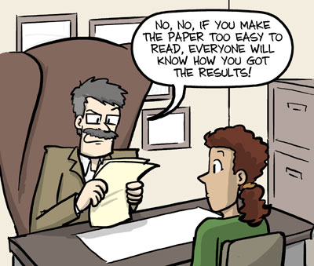
Reproducible Manuscripts
More info here: https://docs.google.com/document/d/1g8GglJWHme1c4ffeVQd3Sn3S9u6enwQ_Q_Ba_NI19Lc/edit#
To accomplish this goal, we want to share a file or set of files that can allow anyone to reproduce the entire manuscript (including text, figures, and numerical results) using the same data and code as the original authors. Thus, a reproducible manuscript inherently implements aspects of a reproducible analysis, though full reproducibility also requires the use of a reproducible analysis platform, as outlined in the Reproducible Analysis section.

Slide 21
Reproducible Manuscripts
More info here: https://docs.google.com/document/d/1g8GglJWHme1c4ffeVQd3Sn3S9u6enwQ_Q_Ba_NI19Lc/edit#
The most commonly used tool for reproducible manuscripts is RMarkdown, generally used within the RStudio environment.
RMarkdown can be installed from within the R environment: install.packages('RMarkdown')
It is possible to include Python code chunks within an RMarkdown file, using the reticulate library. However, this is unlikely to be a satisfying development experience for the Python programmer, since RStudio does not provide the usual tools that one would expect of a Python development environment.
Jupyter notebooks can also be used to generate a document that includes a mixture of code and markdown, which can then be exported to a format suitable for publication.
Jupyter is missing some useful features of RMarkdown, such as the ability to insert variables within the markdown and have their value inserted in the text.

Slide 22
What we’ll touch on today
Reproducibility
Code/Data Sharing
Pre-Registration

Slide 23
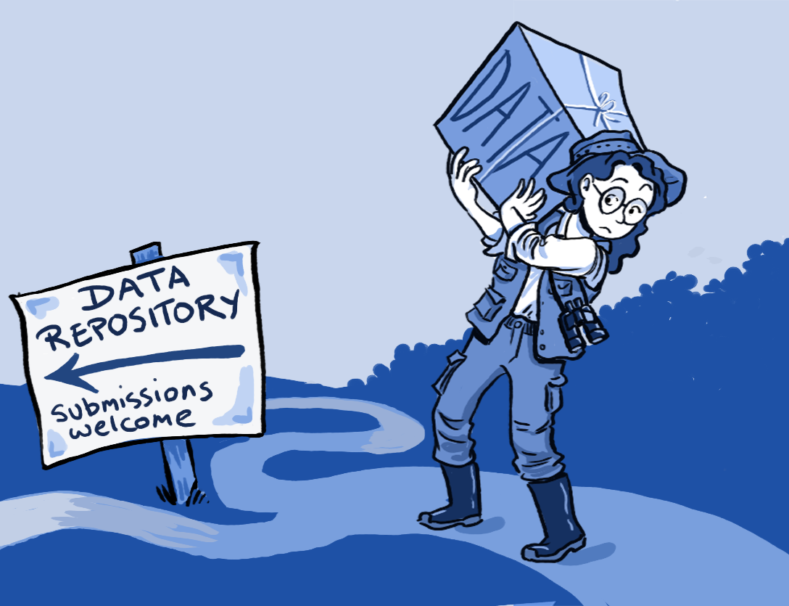
Data Sharing: Why share data?
Collaboration and connection. Sharing data allows one to become a visible member of the open science community, and can lead to new collaborations and recognition of one’s contributions by the broader community.
Improving reproducibility. Without access to the raw data, it is impossible to fully reproduce the results from a published study. Data sharing allows researchers to confirm published findings and test their generalizability (for example, using different analysis methods). In addition, by allowing researchers to combine shared datasets, data sharing improves the statistical power of research, which is directly related to its reproducibility.
Receiving credit for data generation. It is increasingly common for the
generation and sharing of high-value datasets to be viewed as an
important scientific contribution in its own right. This is particularly
evident in the advent of “data papers”, which are publications that
describe a shared dataset and can provide citation credit for shared data.

Slide 24
Data Sharing: Why share data?
Collaboration and connection. Sharing data allows one to become a visible member of the open science community, and can lead to new collaborations and recognition of one’s contributions by the broader community.
Improving reproducibility. Without access to the raw data, it is impossible to fully reproduce the results from a published study. Data sharing allows researchers to confirm published findings and test their generalizability (for example, using different analysis methods). In addition, by allowing researchers to combine shared datasets, data sharing improves the statistical power of research, which is directly related to its reproducibility.
Receiving credit for data generation. It is increasingly common for the
generation and sharing of high-value datasets to be viewed as an
important scientific contribution in its own right. This is particularly
evident in the advent of “data papers”, which are publications that
describe a shared dataset and can provide citation credit for shared data.

Slide 25
Data Sharing: Why share data?
Collaboration and connection. Sharing data allows one to become a visible member of the open science community, and can lead to new collaborations and recognition of one’s contributions by the broader community.
Improving reproducibility. Without access to the raw data, it is impossible to fully reproduce the results from a published study. Data sharing allows researchers to confirm published findings and test their generalizability (for example, using different analysis methods). In addition, by allowing researchers to combine shared datasets, data sharing improves the statistical power of research, which is directly related to its reproducibility.
Receiving credit for data generation. It is increasingly common for the
generation and sharing of high-value datasets to be viewed as an
important scientific contribution in its own right. This is particularly
evident in the advent of “data papers”, which are publications that
describe a shared dataset and can provide citation credit for shared data.

Slide 26
Data Sharing: Why share data?
Responsibility to research participants. One of the fundamental principles of human subjects research outlined in the Belmont Report is the principle of beneficence: “maximize possible benefits and minimize possible harms”. Because failing to share data (while minimizing risks to the participant) will necessarily reduce the possible benefits of the data, there is an ethical argument that researchers are ethically obligated to share data unless the risks to confidentiality and privacy cannot be reduced.
Responsibility to research funders. Most research is funded by taxpayers or private foundations, who expect researchers to maximize the potential benefit of that investment. When researchers fail to share data effectively, they are limiting the potential impact of the funding, by preventing others from using those data to generate additional knowledge or test new hypotheses. In addition, some funding agencies (such as the National Institute of Mental Health and Wellcome Trust) require the sharing of data from research that they fund.
Improving power through data aggregation. There are many cases in which an individual researcher cannot feasibly obtain enough data to robustly test a particular scientific hypothesis. In such cases, the sharing of data across sites can allow a larger consortium of researchers to combine data in order to more robustly ask particular scientific questions.

Slide 27
Data Sharing: Why share data?
Responsibility to research participants. One of the fundamental principles of human subjects research outlined in the Belmont Report is the principle of beneficence: “maximize possible benefits and minimize possible harms”. Because failing to share data (while minimizing risks to the participant) will necessarily reduce the possible benefits of the data, there is an ethical argument that researchers are ethically obligated to share data unless the risks to confidentiality and privacy cannot be reduced.
Responsibility to research funders. Most research is funded by taxpayers or private foundations, who expect researchers to maximize the potential benefit of that investment. When researchers fail to share data effectively, they are limiting the potential impact of the funding, by preventing others from using those data to generate additional knowledge or test new hypotheses. In addition, some funding agencies (such as the National Institute of Mental Health and Wellcome Trust) require the sharing of data from research that they fund.
Improving power through data aggregation. There are many cases in which an individual researcher cannot feasibly obtain enough data to robustly test a particular scientific hypothesis. In such cases, the sharing of data across sites can allow a larger consortium of researchers to combine data in order to more robustly ask particular scientific questions.

Slide 28
Data Sharing: Why share data?
Responsibility to research participants. One of the fundamental principles of human subjects research outlined in the Belmont Report is the principle of beneficence: “maximize possible benefits and minimize possible harms”. Because failing to share data (while minimizing risks to the participant) will necessarily reduce the possible benefits of the data, there is an ethical argument that researchers are ethically obligated to share data unless the risks to confidentiality and privacy cannot be reduced.
Responsibility to research funders. Most research is funded by taxpayers or private foundations, who expect researchers to maximize the potential benefit of that investment. When researchers fail to share data effectively, they are limiting the potential impact of the funding, by preventing others from using those data to generate additional knowledge or test new hypotheses. In addition, some funding agencies (such as the National Institute of Mental Health and Wellcome Trust) require the sharing of data from research that they fund.
Improving power through data aggregation. There are many cases in which an individual researcher cannot feasibly obtain enough data to robustly test a particular scientific hypothesis. In such cases, the sharing of data across sites can allow a larger consortium of researchers to combine data in order to more robustly ask particular scientific questions.

Slide 29
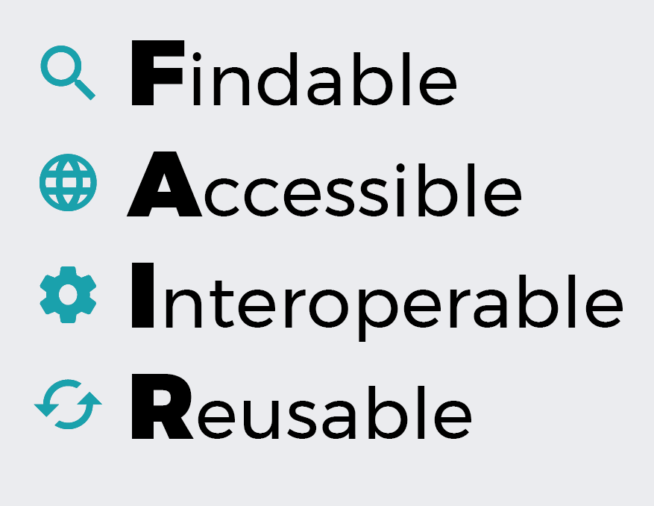
Data Sharing: The FAIR Principles
The FAIR principles describe a set of features that shared data should have in order to be maximally useful. Shared data should be:
Findable: discoverable with metadata, identifiable and locatable by means of a standard identification mechanism
Accessible: always available and obtainable; even if the data is restricted, the metadata is open
Interoperable: both parseable and understandable, allowing data exchange and reuse between researchers, institutions, organisations or countries
Reusable: sufficiently described and shared with the least restrictive licences, allowing the widest reuse possible and the least cumbersome integration with other data sources.
See here for more on how to make one’s data FAIR.

Slide 30
Data Sharing: How?
More info here: https://docs.google.com/document/d/1k7f23L4WqDGUUGjkUf03emLlsdDLRr4aponQ6jOFv1s/edit#
Step 1: Plan for sharing (prior to data collection):
In the United States, the sharing of data is governed by federal regulations including Health Insurance Portability and Accountability Act of 1996 (HIPAA) Privacy Rule. This rule states data that have been deidentified are not treated as “protected health information” (PHI) and their sharing is not restricted.
Step 2: Organize your data and metadata
It is best to use a consistent organizational scheme for all of one’s projects that involve similar data types. This will allow reusability of analysis code, as well as allowing one to more easily find data of interest long after they have been used.
Step 3: Determine the most appropriate repository
It is best to choose a repository that follows the FAIR principles
The repository should provide a persistent identifier for the data (such as a digital object identifier [DOI] or permanent URL [PURL])
The repository should provide the ability to denote specific versions of the data
Step 4: Determine the terms of sharing for your data
All shared data should be accompanied by a set of terms under which the data are released. This makes it clear to any potential user of the data what rights and obligations they have, and prevents them from needing to contact you with questions about these issues.

Slide 31
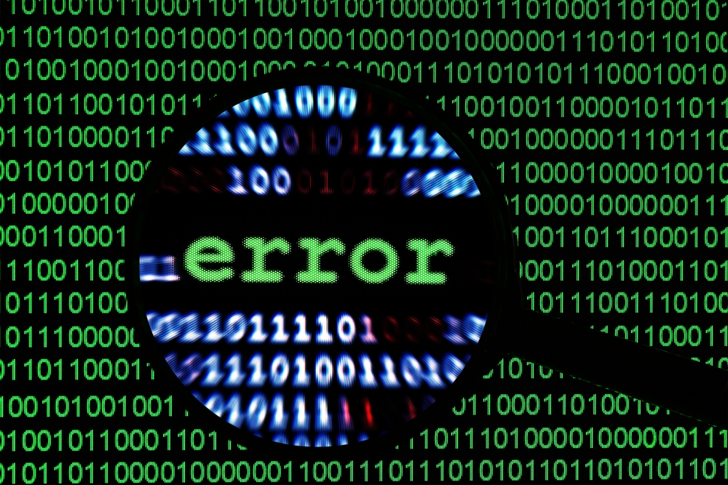
Data Sharing: What if I discover an error in my data?
The need to fix errors highlights the importance of using a repository that allows versioning of the data.
Some repositories allow one to simply upload a revised version of the data
Consider writing a description for the README file describing the error and how it was resolved.
Alternatively, include a CHANGES file that details all changes made to the data for each version.
For repositories that involve manual submission, immediately reach out to the repository hosting the data. describing what the error is and how you would like to proceed with remedying it.

Slide 32
Code Sharing: Why share code?
Sharing your code improves reproducibility. If someone reads your code and is surprised by the results, they can take your code and immediately run it on your or other data, insteading of having to take the time to estimate your code from scratch using the manuscript, potentially introducing misinterpretations or bugs resulting in different results for non interesting reasons.
Your code makes things transparent. It makes many choices explicit that are normally implicit or nonexistent in published manuscripts (How did you clean the data? How did you implement the model? Are there any idiosyncratic choices that went unmentioned previously?).
Online code supports collaboration. You are a busy scientist, and in the case that someone wants to reuse/repurpose/extend your code, there can be a large start up cost of time and energy for both you and the potential collaborator to find time to share code and go over how to use it. Making your code available online, organized with READMEs and a license can decrease the overhead on getting a potential collaborator started, speeding up the scientific process.
More eyes on a project can catch more errors. Errors are bound to happen, whether they come in the form of typos, misordered lines, accidental assumptions, or more insidious forms.
Creating shareable code from the beginning can actually save you time. Using versioning and other habits of shareable coding can prevent irreparably breaking code, and can help you keep track of the changes you’ve made in the process of creating the code.

Slide 33
Code Sharing: Why share code?
Sharing your code improves reproducibility. If someone reads your code and is surprised by the results, they can take your code and immediately run it on your or other data, insteading of having to take the time to estimate your code from scratch using the manuscript, potentially introducing misinterpretations or bugs resulting in different results for non interesting reasons.
Your code makes things transparent. It makes many choices explicit that are normally implicit or nonexistent in published manuscripts (How did you clean the data? How did you implement the model? Are there any idiosyncratic choices that went unmentioned previously?).
Online code supports collaboration. You are a busy scientist, and in the case that someone wants to reuse/repurpose/extend your code, there can be a large start up cost of time and energy for both you and the potential collaborator to find time to share code and go over how to use it. Making your code available online, organized with READMEs and a license can decrease the overhead on getting a potential collaborator started, speeding up the scientific process.
More eyes on a project can catch more errors. Errors are bound to happen, whether they come in the form of typos, misordered lines, accidental assumptions, or more insidious forms.
Creating shareable code from the beginning can actually save you time. Using versioning and other habits of shareable coding can prevent irreparably breaking code, and can help you keep track of the changes you’ve made in the process of creating the code.

Slide 34
Code Sharing: Why share code?
Sharing your code improves reproducibility. If someone reads your code and is surprised by the results, they can take your code and immediately run it on your or other data, insteading of having to take the time to estimate your code from scratch using the manuscript, potentially introducing misinterpretations or bugs resulting in different results for non interesting reasons.
Your code makes things transparent. It makes many choices explicit that are normally implicit or nonexistent in published manuscripts (How did you clean the data? How did you implement the model? Are there any idiosyncratic choices that went unmentioned previously?).
Online code supports collaboration. You are a busy scientist, and in the case that someone wants to reuse/repurpose/extend your code, there can be a large start up cost of time and energy for both you and the potential collaborator to find time to share code and go over how to use it. Making your code available online, organized with READMEs and a license can decrease the overhead on getting a potential collaborator started, speeding up the scientific process.
More eyes on a project can catch more errors. Errors are bound to happen, whether they come in the form of typos, misordered lines, accidental assumptions, or more insidious forms.
Creating shareable code from the beginning can actually save you time. Using versioning and other habits of shareable coding can prevent irreparably breaking code, and can help you keep track of the changes you’ve made in the process of creating the code.

Slide 35
Code Sharing: Why share code?
Sharing your code improves reproducibility. If someone reads your code and is surprised by the results, they can take your code and immediately run it on your or other data, insteading of having to take the time to estimate your code from scratch using the manuscript, potentially introducing misinterpretations or bugs resulting in different results for non interesting reasons.
Your code makes things transparent. It makes many choices explicit that are normally implicit or nonexistent in published manuscripts (How did you clean the data? How did you implement the model? Are there any idiosyncratic choices that went unmentioned previously?).
Online code supports collaboration. You are a busy scientist, and in the case that someone wants to reuse/repurpose/extend your code, there can be a large start up cost of time and energy for both you and the potential collaborator to find time to share code and go over how to use it. Making your code available online, organized with READMEs and a license can decrease the overhead on getting a potential collaborator started, speeding up the scientific process.
More eyes on a project can catch more errors. Errors are bound to happen, whether they come in the form of typos, misordered lines, accidental assumptions, or more insidious forms.
Creating shareable code from the beginning can actually save you time. Using versioning and other habits of shareable coding can prevent irreparably breaking code, and can help you keep track of the changes you’ve made in the process of creating the code.

Slide 36
Code Sharing: Why share code?
Sharing your code improves reproducibility. If someone reads your code and is surprised by the results, they can take your code and immediately run it on your or other data, insteading of having to take the time to estimate your code from scratch using the manuscript, potentially introducing misinterpretations or bugs resulting in different results for non interesting reasons.
Your code makes things transparent. It makes many choices explicit that are normally implicit or nonexistent in published manuscripts (How did you clean the data? How did you implement the model? Are there any idiosyncratic choices that went unmentioned previously?).
Online code supports collaboration. You are a busy scientist, and in the case that someone wants to reuse/repurpose/extend your code, there can be a large start up cost of time and energy for both you and the potential collaborator to find time to share code and go over how to use it. Making your code available online, organized with READMEs and a license can decrease the overhead on getting a potential collaborator started, speeding up the scientific process.
More eyes on a project can catch more errors. Errors are bound to happen, whether they come in the form of typos, misordered lines, accidental assumptions, or more insidious forms.
Creating shareable code from the beginning can actually save you time. Using versioning and other habits of shareable coding can prevent irreparably breaking code, and can help you keep track of the changes you’ve made in the process of creating the code.

Slide 37
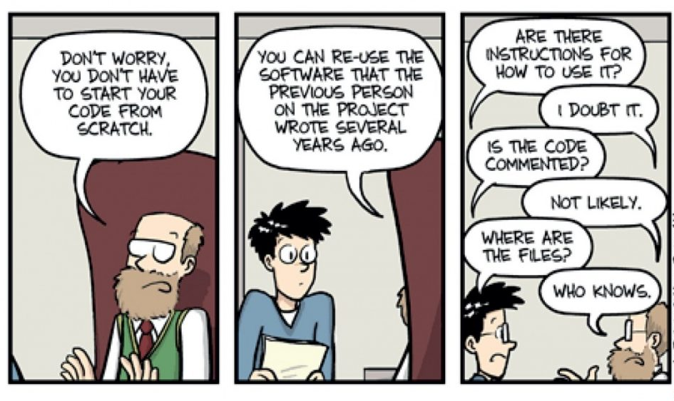
Code Sharing
Step 1: Set up git and Github
Step 2: Choose a license for your code
Step 3: Create a new repository on Github, and clone it to your computers
Step 4: Organize your code
Step 5: Commit your code to the local repository
Step 6: Push your changes to Github
Step 7: Push your code to the repository
More info here: https://docs.google.com/document/d/1sirA13NJsmxpI6DTdHhX4qAKcAz2q8155v--pDmAvNE/edit#

Slide 38
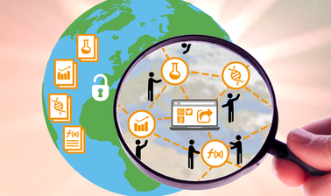
Happy open science-ing!

